Slide 1

Grocery Store Management Using SQL
Presented By:
Name : Boddu Shireesha
Batch : 456

Slide 2
Agenda
Introduction
Business Problem
Objective of the Project
ER Diagram and schema explanation
Relationship Between The Tables
Customer Insights
Product Performance
Sales and Order Trends
Supplier Contribution
Employee Performance
Order Details Deep Dive
Final business insights
Recommendations
Conclusion

Slide 3
Business problem
The grocery store faces inconsistent revenue and excess inventory because it cannot clearly identify high-performing products and slow-moving items.
Management lacks visibility into which customers, suppliers, and employees contribute the most to overall sales and profitability.
Due to the absence of structured data analysis, decision-making related to inventory planning, marketing strategies, and performance evaluation is not data-driven.
Business Problem Statement
The grocery store lacked clear insights into sales performance, customer behavior, supplier contribution, and employee efficiency.
To address this issue, I used MySQL to design a structured relational database and analyze the transactional data using SQL queries.
The analysis generated meaningful insights that support better decision-making and improve overall business performance.

Slide 4
Introduction
This project involves designing and analyzing a Grocery Store Management database using SQL. The aim is to study customer behavior, product performance, sales trends, supplier contribution, and employee efficiency to generate meaningful business insights. The analysis helps the store make better data-driven decisions to improve profitability and operations.

Slide 5
Objectives
To design and implement a relational database for a grocery store using SQL.
To analyze customer purchasing behavior and identify high-value customers.
To evaluate product performance and identify top-selling and slow-moving products.
To study monthly sales trends and revenue patterns.
To assess supplier contribution to overall sales.
To measure employee performance based on sales handled.

Slide 6
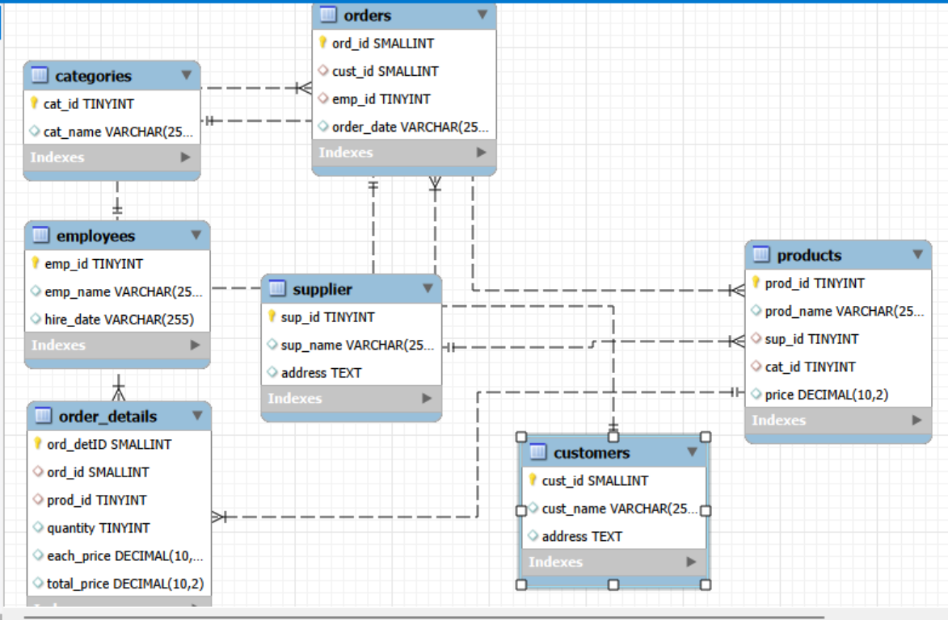
ER Diagram

Slide 7
Relationship Between The Tables
One-to-Many from supplier to products
One-to-Many from categories to products
One-to-Many from products to order_details
One-to-Many from orders to order_details
One-to-Many from customers to orders
One-to-Many from employees to orders

Slide 8
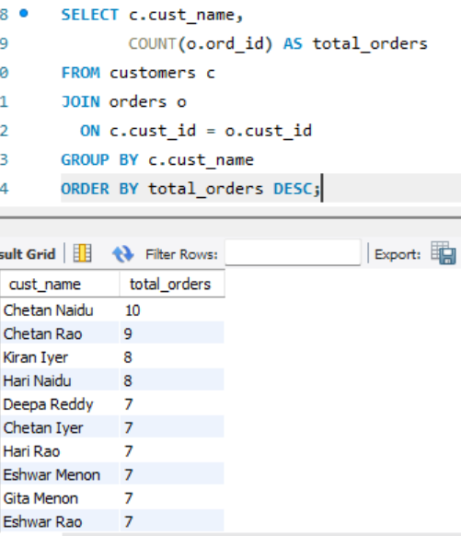
Customer Insights
Which customers have placed highest number of orders ?

Slide 9
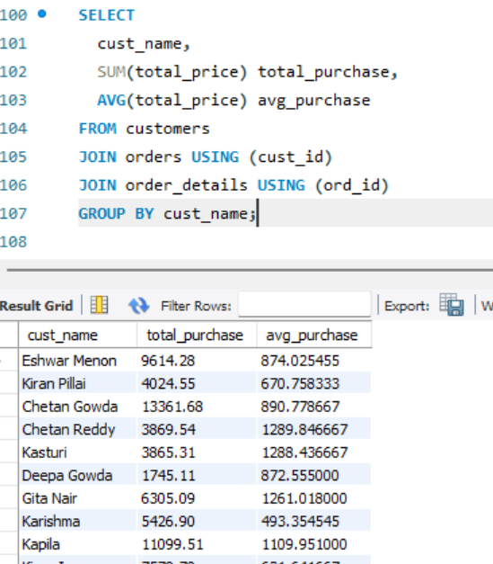
What is the total and average purchase value per customer?

Slide 10
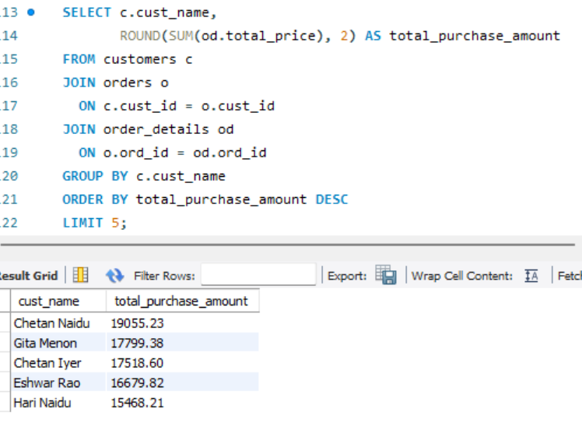
Who are the top 5 customers by total purchase amount?

Slide 11
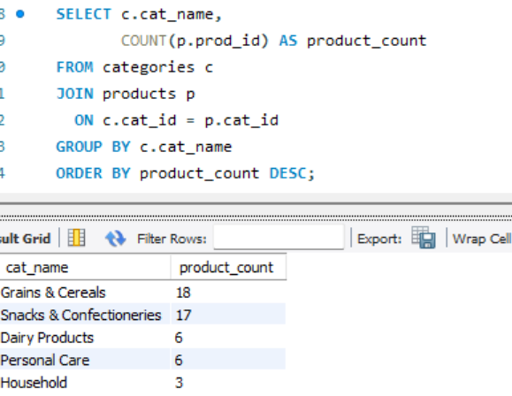
Product Performance
How many products exist in each category?

Slide 12
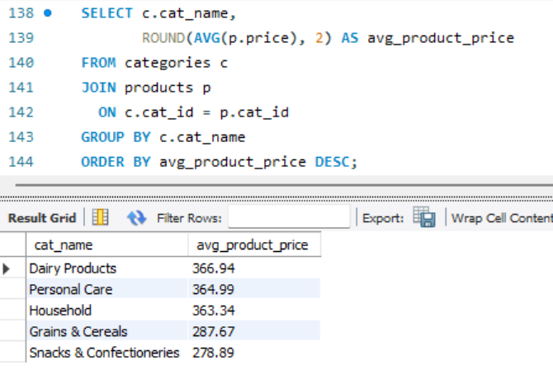
What is the average price of products by category?

Slide 13
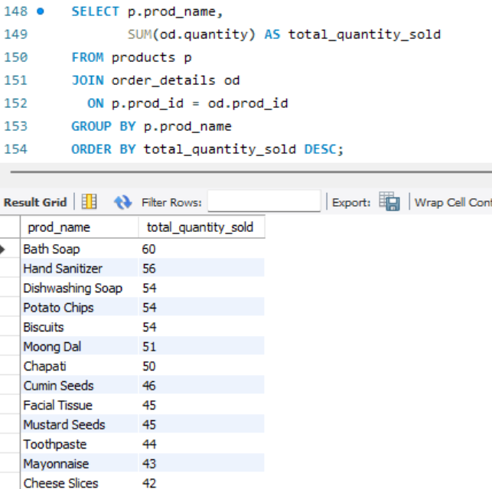
Which products have the highest total sales volume (by quantity)?

Slide 14
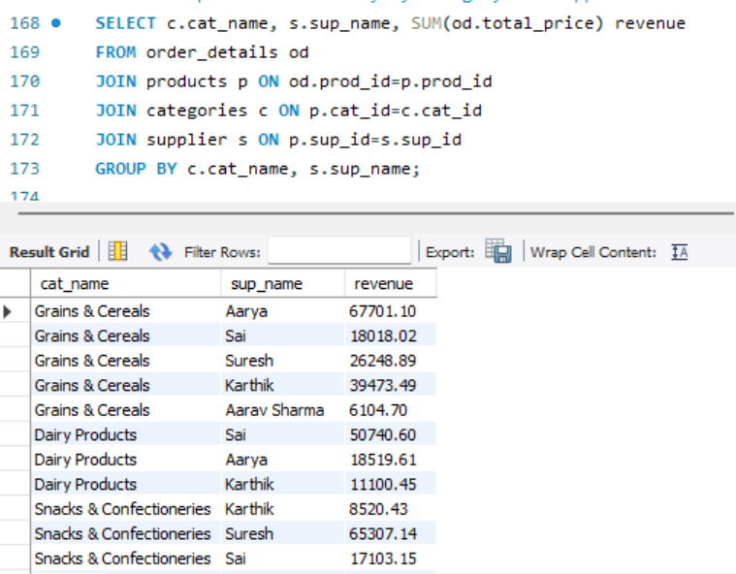
How do product sales vary by category and supplier?

Slide 15
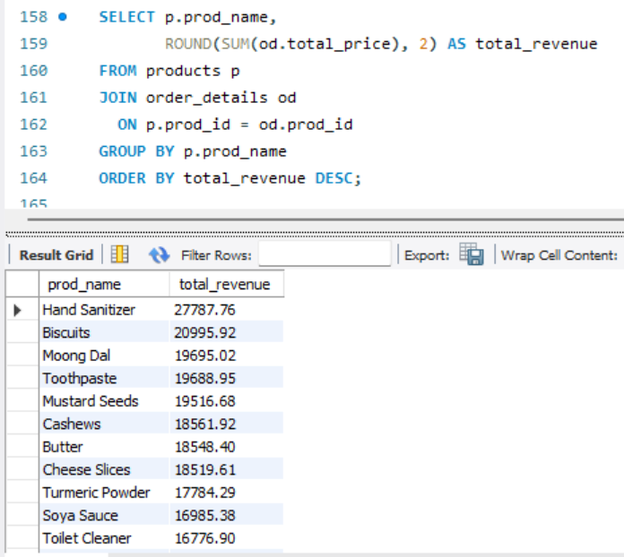
What is the total revenue generated by each product?

Slide 16
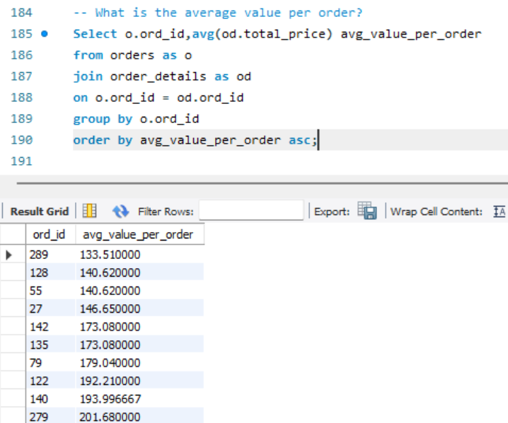
Sales and Order Trends
What is the average value per order?

Slide 17
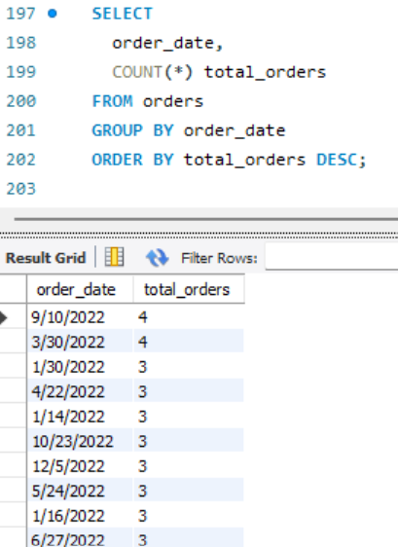
On which dates were the most orders placed?

Slide 18
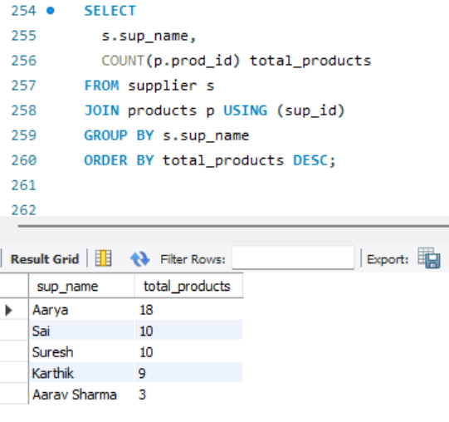
Supplier Contribution
Which supplier provides the most products?

Slide 19
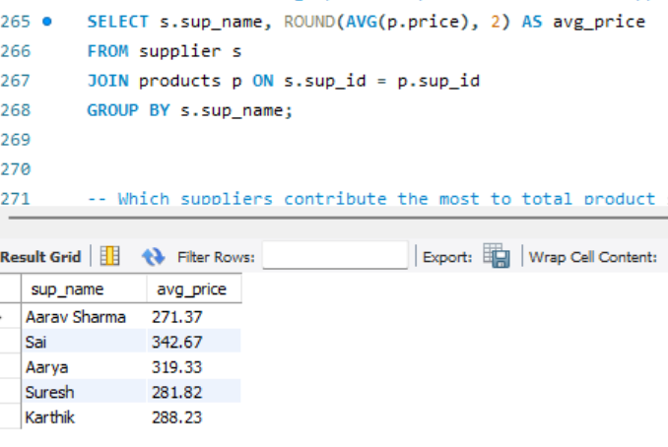
What is the average price of products from each supplier?

Slide 20
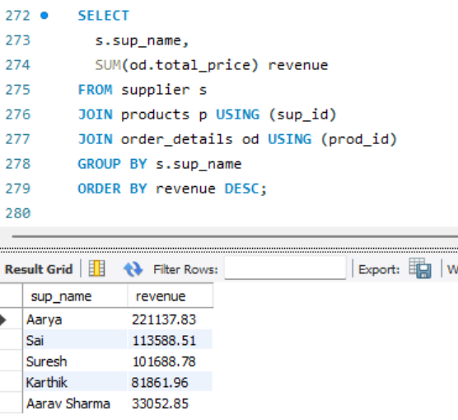
Which suppliers contribute the most to total product sales (by revenue)

Slide 21
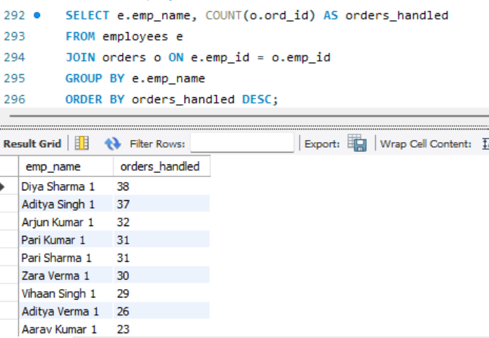
Employee Performance
Which employees have handled the most orders?

Slide 22
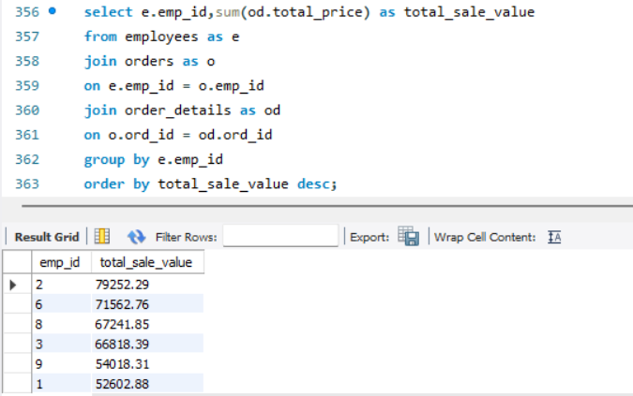
What is the total sales value processed by each employee?

Slide 23
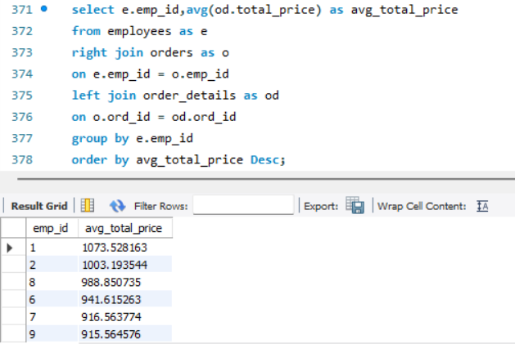
What is the average order value handled per employee?

Slide 24
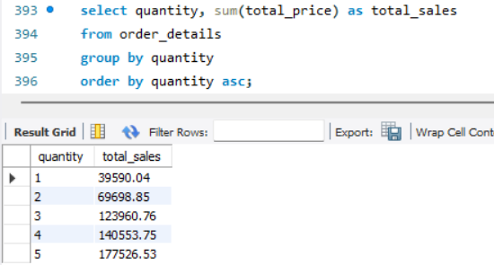
Order Details Deep Dive
What is the relationship between quantity ordered and total price?

Slide 25
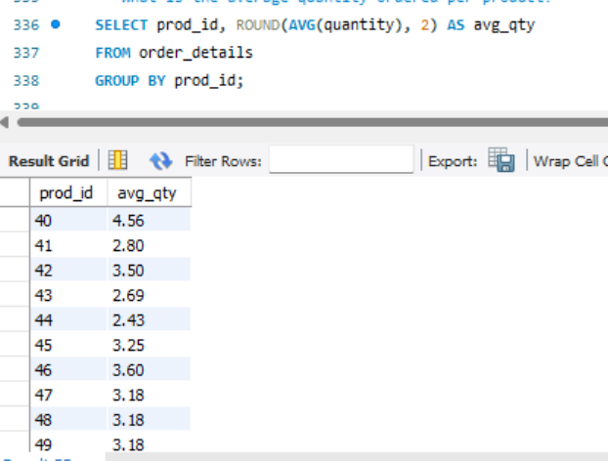
What is the average quantity ordered per product?

Slide 26
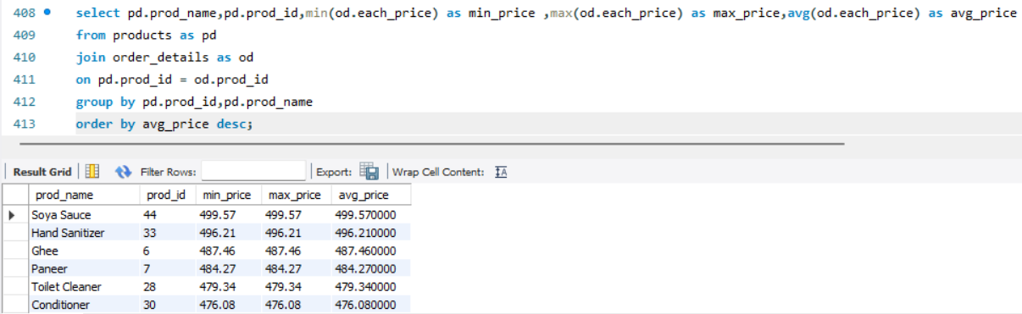
How does the unit price vary across products and orders?

Slide 27
Business Insights
A small number of customers generate most of the revenue.
Few products and categories drive the majority of sales.
Sales show monthly fluctuations, indicating seasonal trends.
Some suppliers contribute significantly more revenue than others.
Employee sales performance varies across orders.

Slide 28
Business Recommendations
Introduce loyalty programs to retain high-value customers.
Promote top-selling products and reduce stock of slow-moving items.
Plan marketing campaigns during low-sales months to stabilize revenue.
Strengthen partnerships with high-performing suppliers and review low-performing ones.
Implement performance incentives and training programs for employees to improve sales efficiency.

Slide 29
Conclusion
In conclusion, this project showcases the power of SQL in transforming raw retail data into strategic business intelligence. By analyzing customers, products, suppliers, employees, and sales trends, the study uncovers key revenue drivers and operational gaps within the grocery store.
The insights generated enable smarter inventory management, stronger supplier decisions, improved employee performance tracking, and targeted customer strategies. Ultimately, this project highlights how data-driven analysis can support sustainable growth and create a competitive advantage in the retail industry.

Slide 30
Any
Questions

Slide 31

THANK YOU

